Slide 1
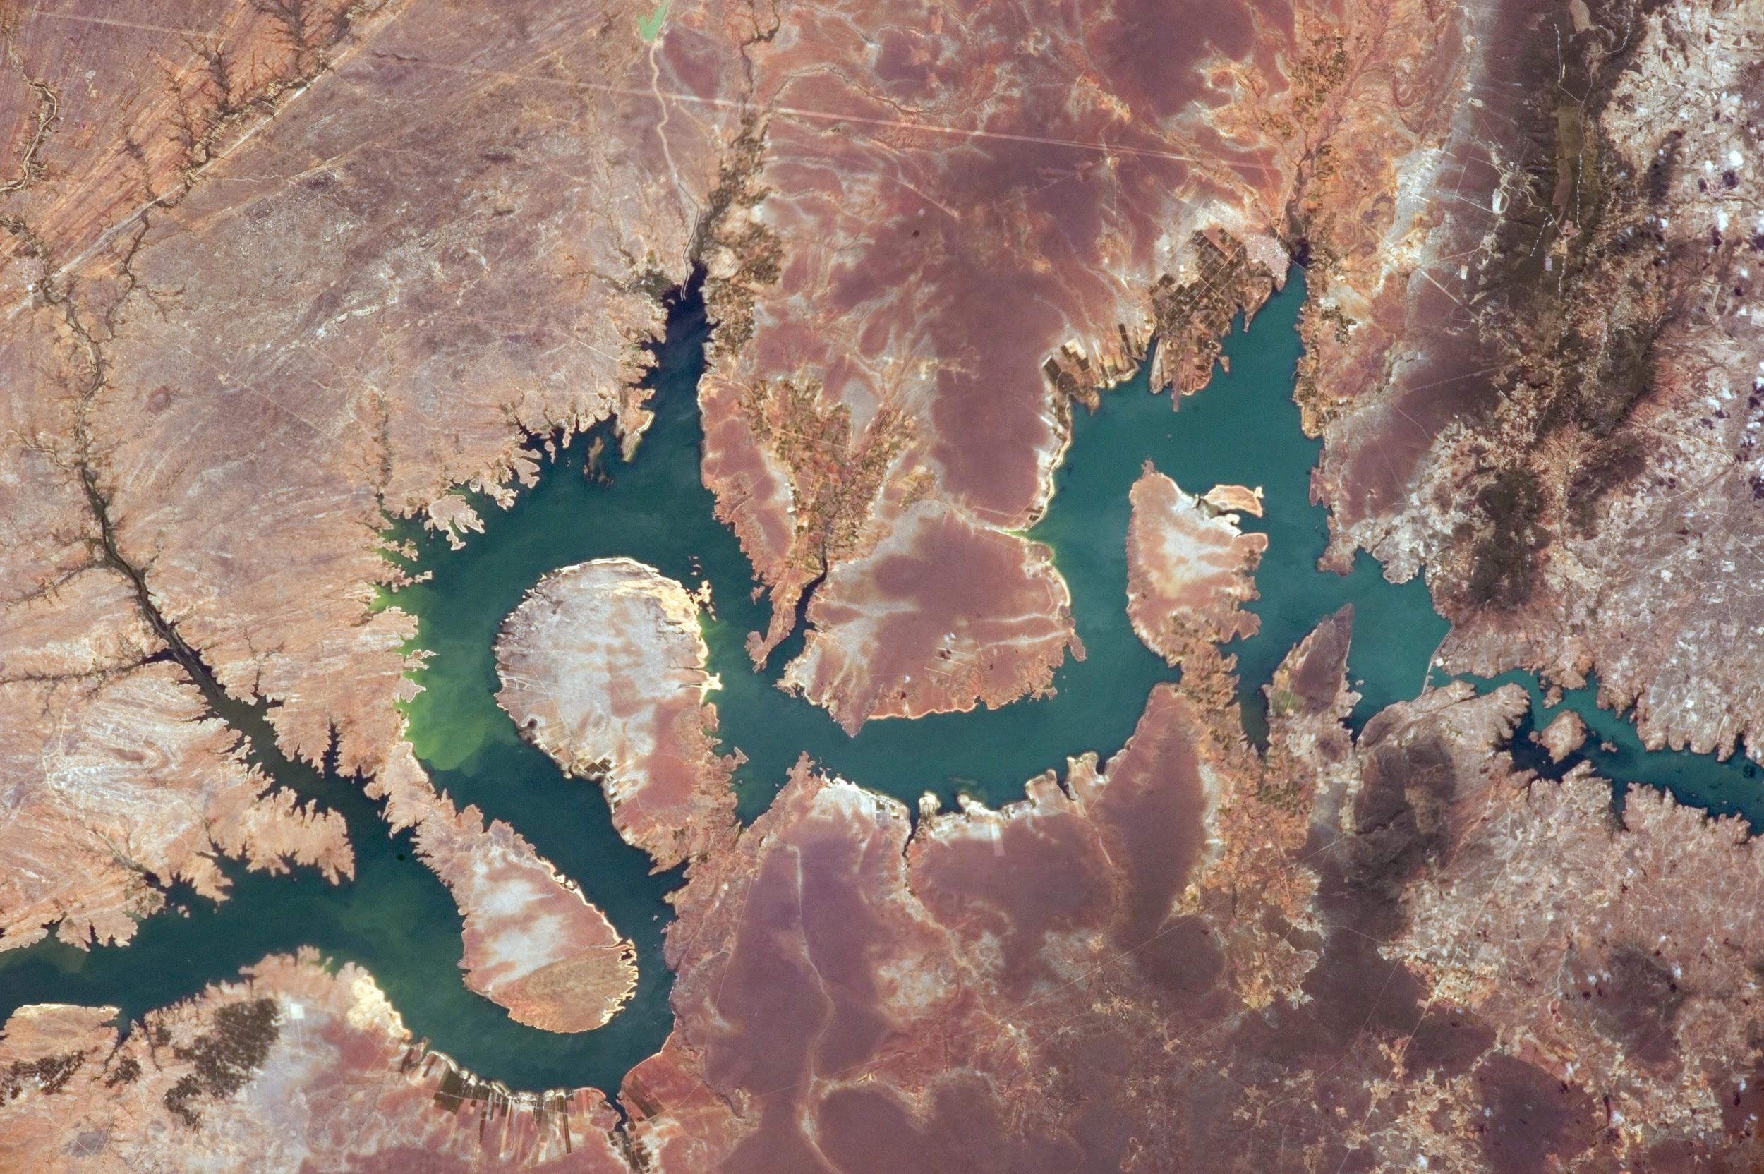




Green Infrastructure for Blue Energy: priority investments for Brazil's dams
Mark Mulligan, King's College London
Sophia Burke, AmbioTEK
mark.mulligan@kcl.ac.uk @markmulligan
www.policysupport.org/waterworld
www.globaldamwatch.org
A systematic analysis to support decision-making of the hydropower sector in adopting Nature-based solutions

Slide 2
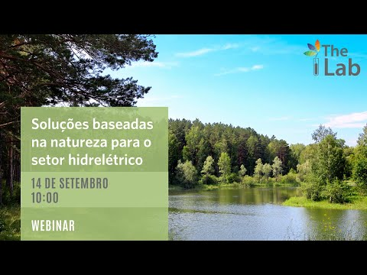
Introduction
Methods
GDW Knowledge base
BEM metrics
WaterWorld scenarios
Results by dam (Brazil)
Investment priorities
Conservation vs restoration
Conclusions
BME Toolkit training (theory)

Slide 3
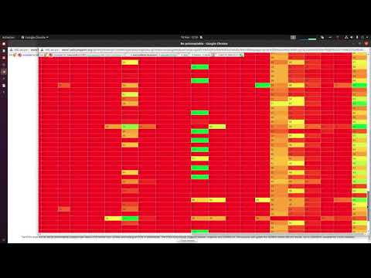
Introduction
GDW Knowledge base
Choosing a basin
Checking dam data
Snapping dam data
Downloading GDW data
Uploading POIs in WaterWorld
Setting up baseline and scenarios
Defor scenario
Refor scenario
Visualising defor scenario
Visualising refor scenario
Calculating BEM metrics
Visualising BEM metrics
Overall investment priority
Greatest investment priority
Visualising BEM metrics by dam
Linking to a GDW dam record
Visualising BEM metrics spatially
Accessing all BEM metrics for a dam
Conclusions
BME Toolkit training (practical)

Slide 4
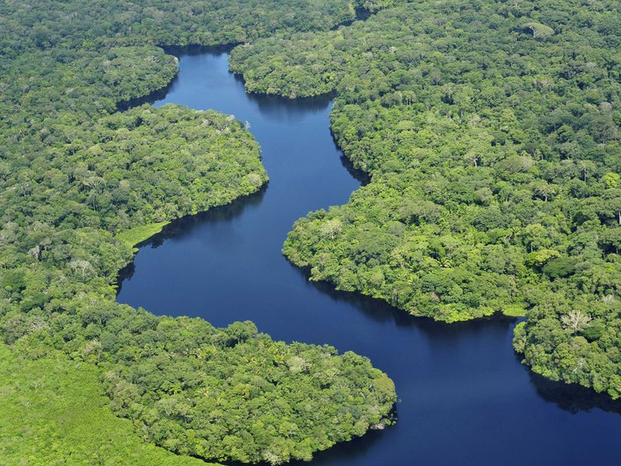


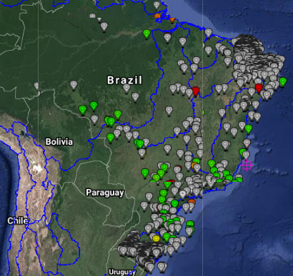
Methods
Sophisticated spatial hydrological model (WaterWorld) driven by best available spatial environmental data
Applied to each of Brazil's major basins (Amazon, East-Brazil South, La Plata, North-Brazil South, Parnaiba, Sao-Francisco, Tocantins, Uruguay Brazil South)
35 hydrological metrics calculated to assess the role of upstream nature "green infrastructure" (forests, cloud-forests, semi-natural, protected) for dam operation, with respect to water quantity, water regulation, water quality and sediments
Calculated metrics cover:
  Current state of upstream nature
  Current contribution of upstream nature to dam operation
  Current contribution of investable natural assets to dam operation
  Current and future risks to contribution of upstream nature to dam operation
  Future benefits to dam operation associated with restoration of upstream nature
Metrics combine in maps of overall priority for green infrastructure investment and the greatest priority activity for investment
Results extracted for 608 HEP dams for Brazil from GDW

Slide 5
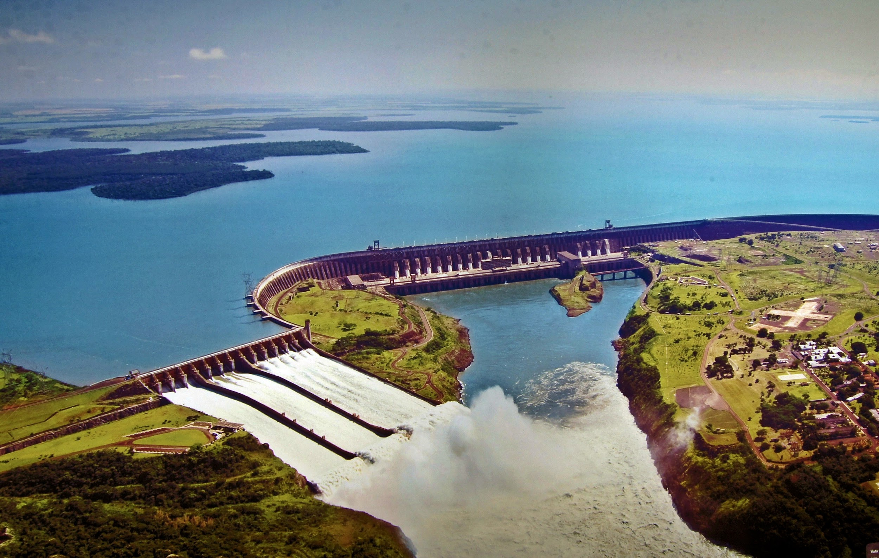
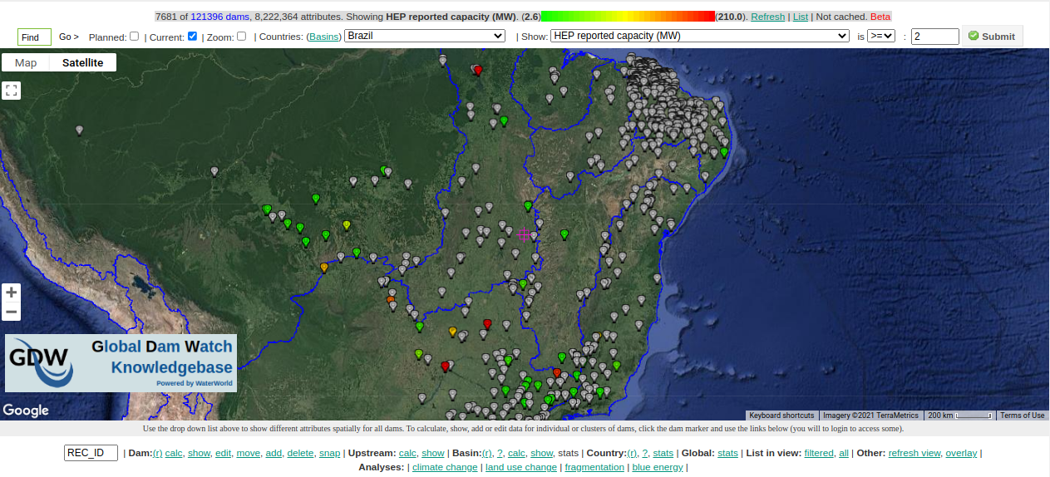
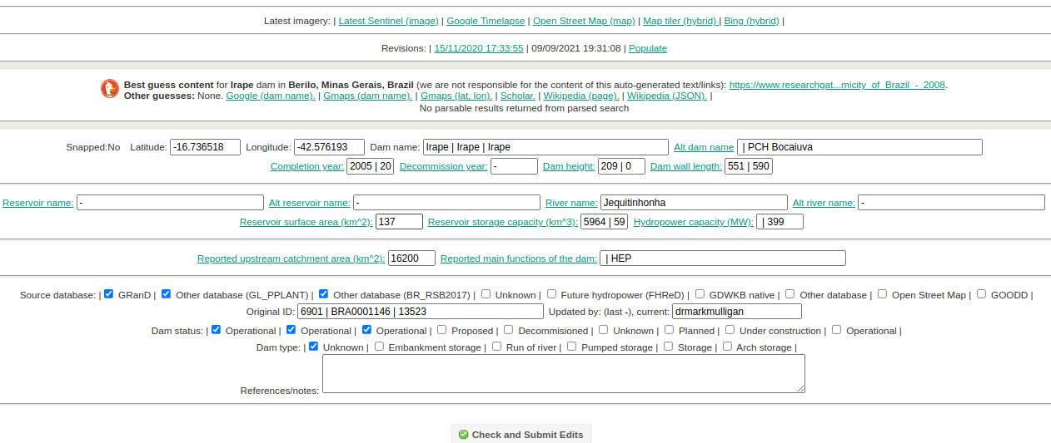
Global Dam Watch KB is an open data platform with >120K dams and their attributes
Combines a range of other global databases including GOODD, GranD and Future Hydropower (FHRED)
Open access at http://www.policysupport.org/globaldamwatch

Slide 6
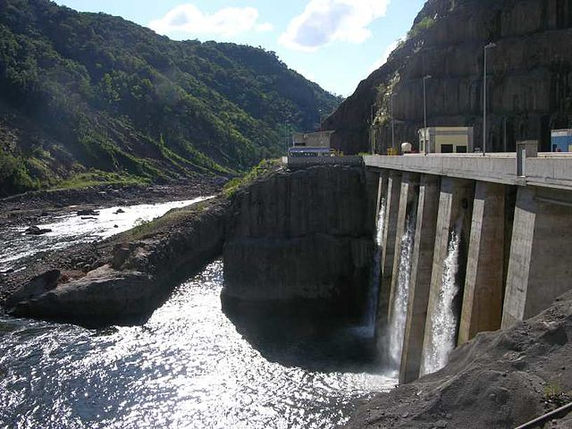
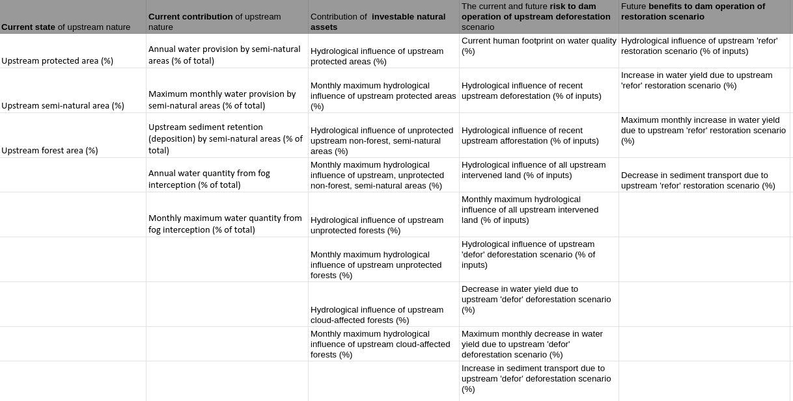
BEM spatial metrics calculated
We calculate 35 hydrological metrics in WaterWorld. These metrics calculate the current state of upstream nature, its contribution to supporting water and sediment retention at the dams downstream, the contribution of specific investible natural assets (eg protected areas, unprotected forest, cloud forest), risk to the dams of upstream deforestation and benefits of upstream restoration.

Slide 7
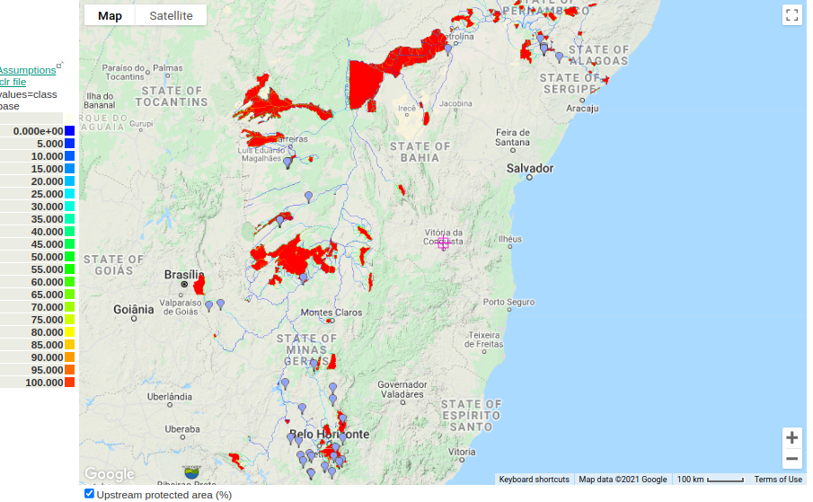
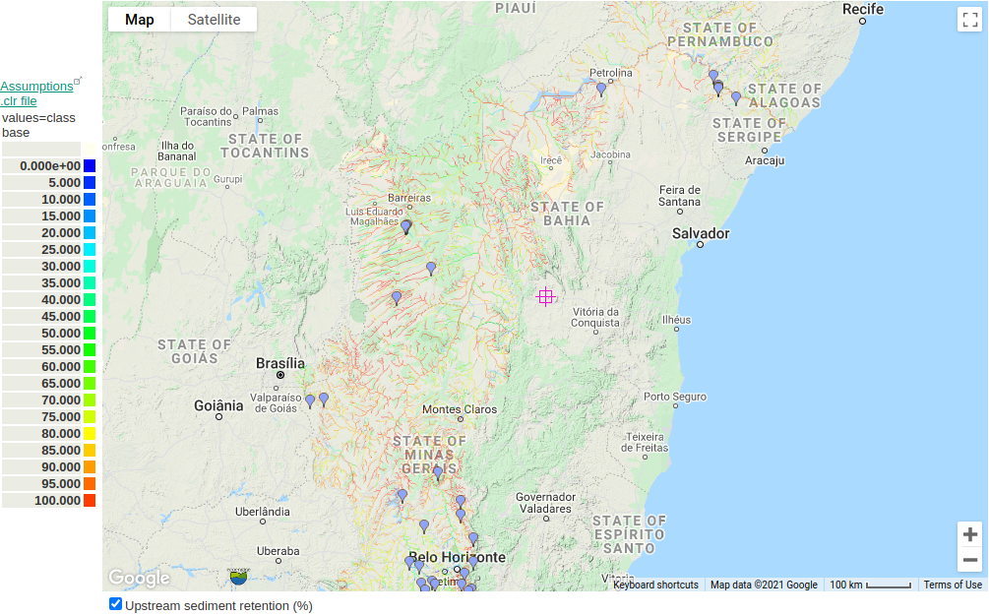
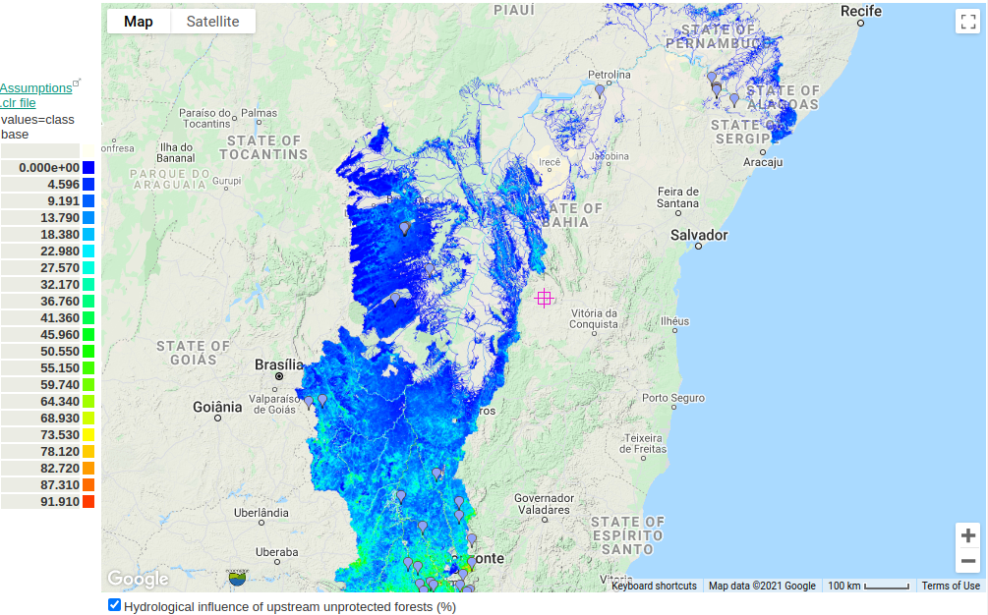
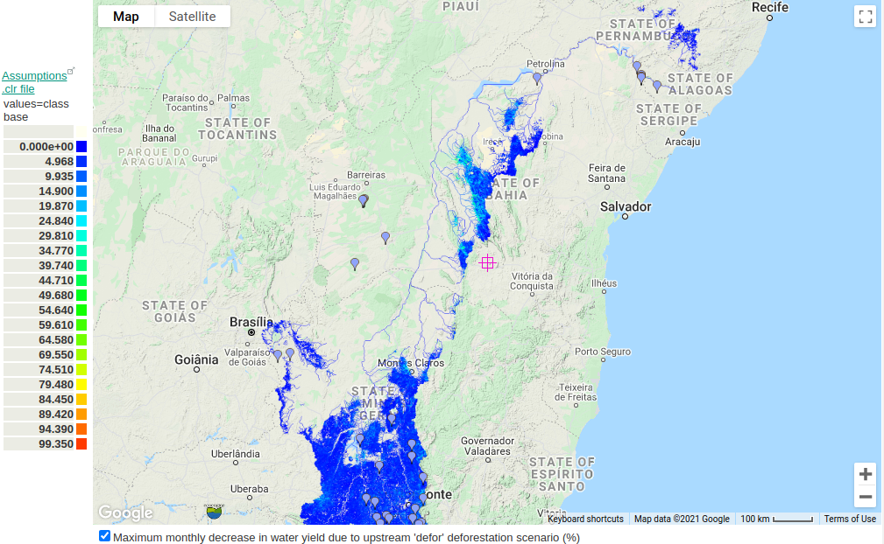
Example spatial metrics
STATE: Upstream protected area (%)
CON: Upstream sediment retention (%)
ASSETS: Influence of upstream unprotected forest (%)
RISK: Max. monthly water yield decrease on defor (%)
Notes:
Here are some example outputs for the Sao Francisco basin

Slide 8
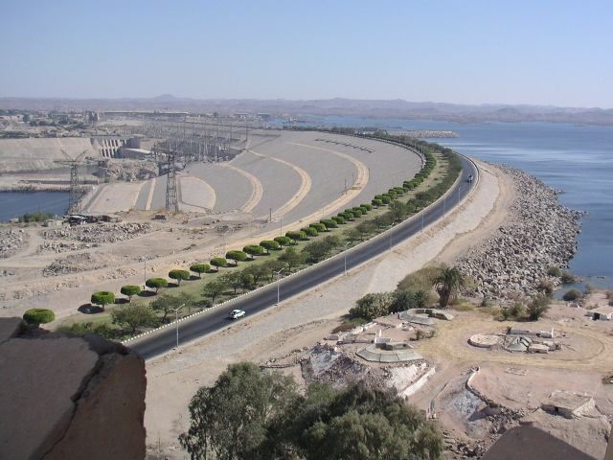
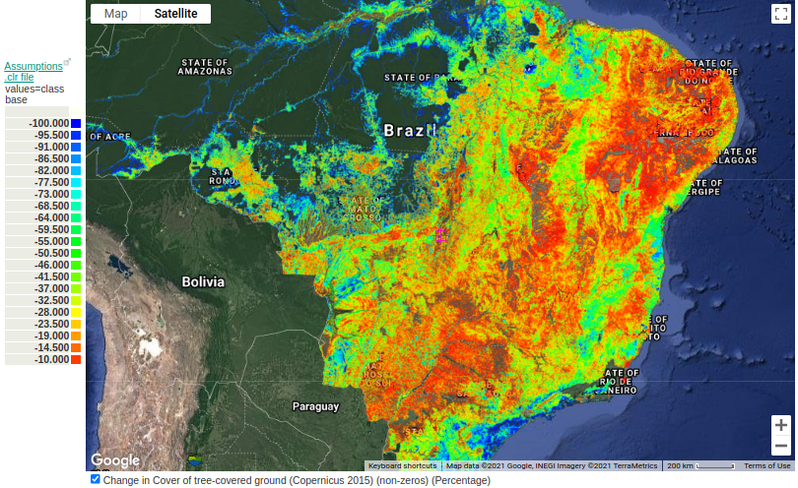
BAU deforestation scenario (100 years)
As part of the analysis we run a deforestation scenario. Coloured areas are deforested

Slide 9
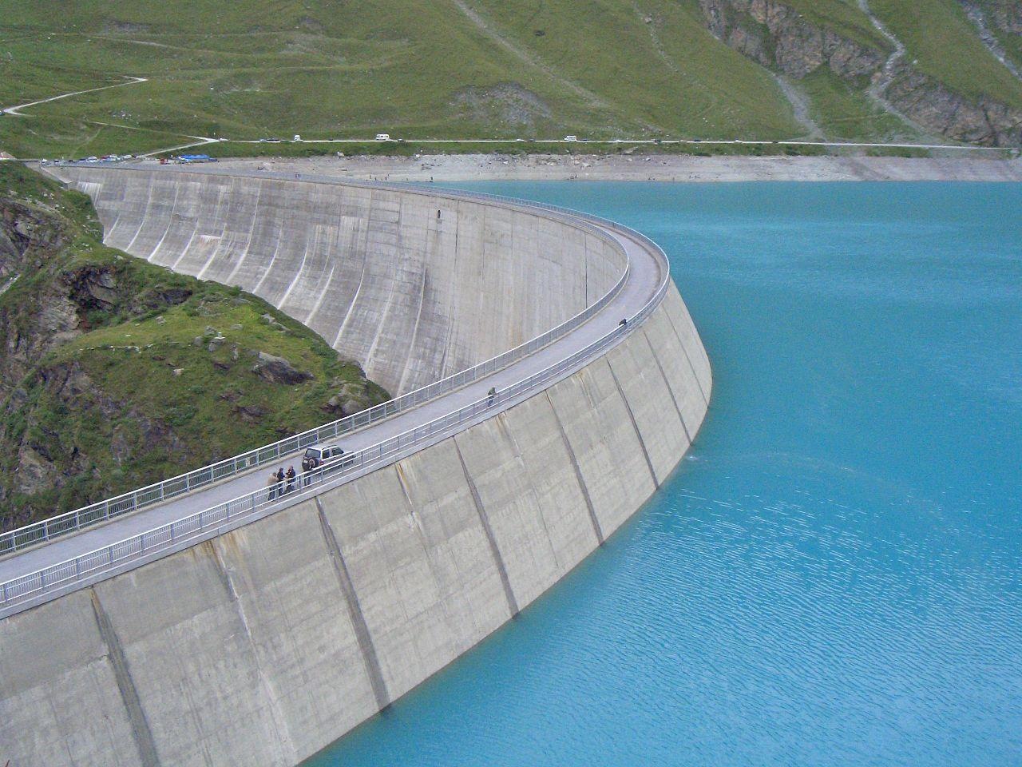
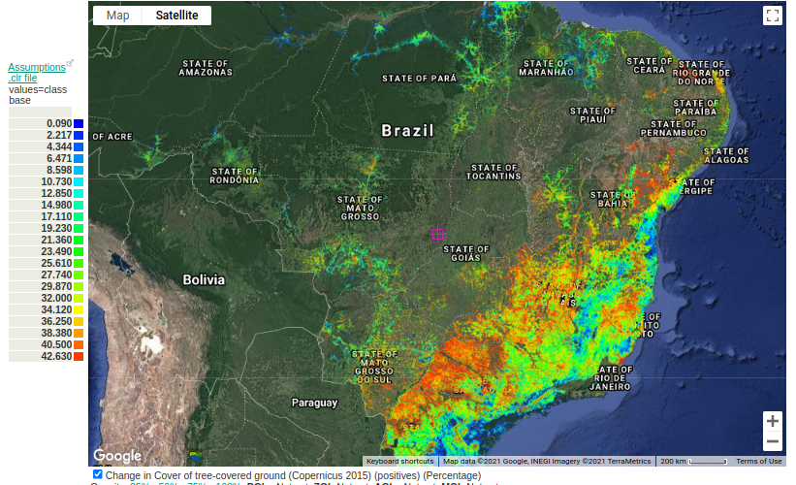
BAU reforestation scenario (100 years)
We also run a forest restoration scenario. The coloured areas are restored.
Notes:
We also run a forest restoration scenario. The coloured areas are restored.

Slide 10
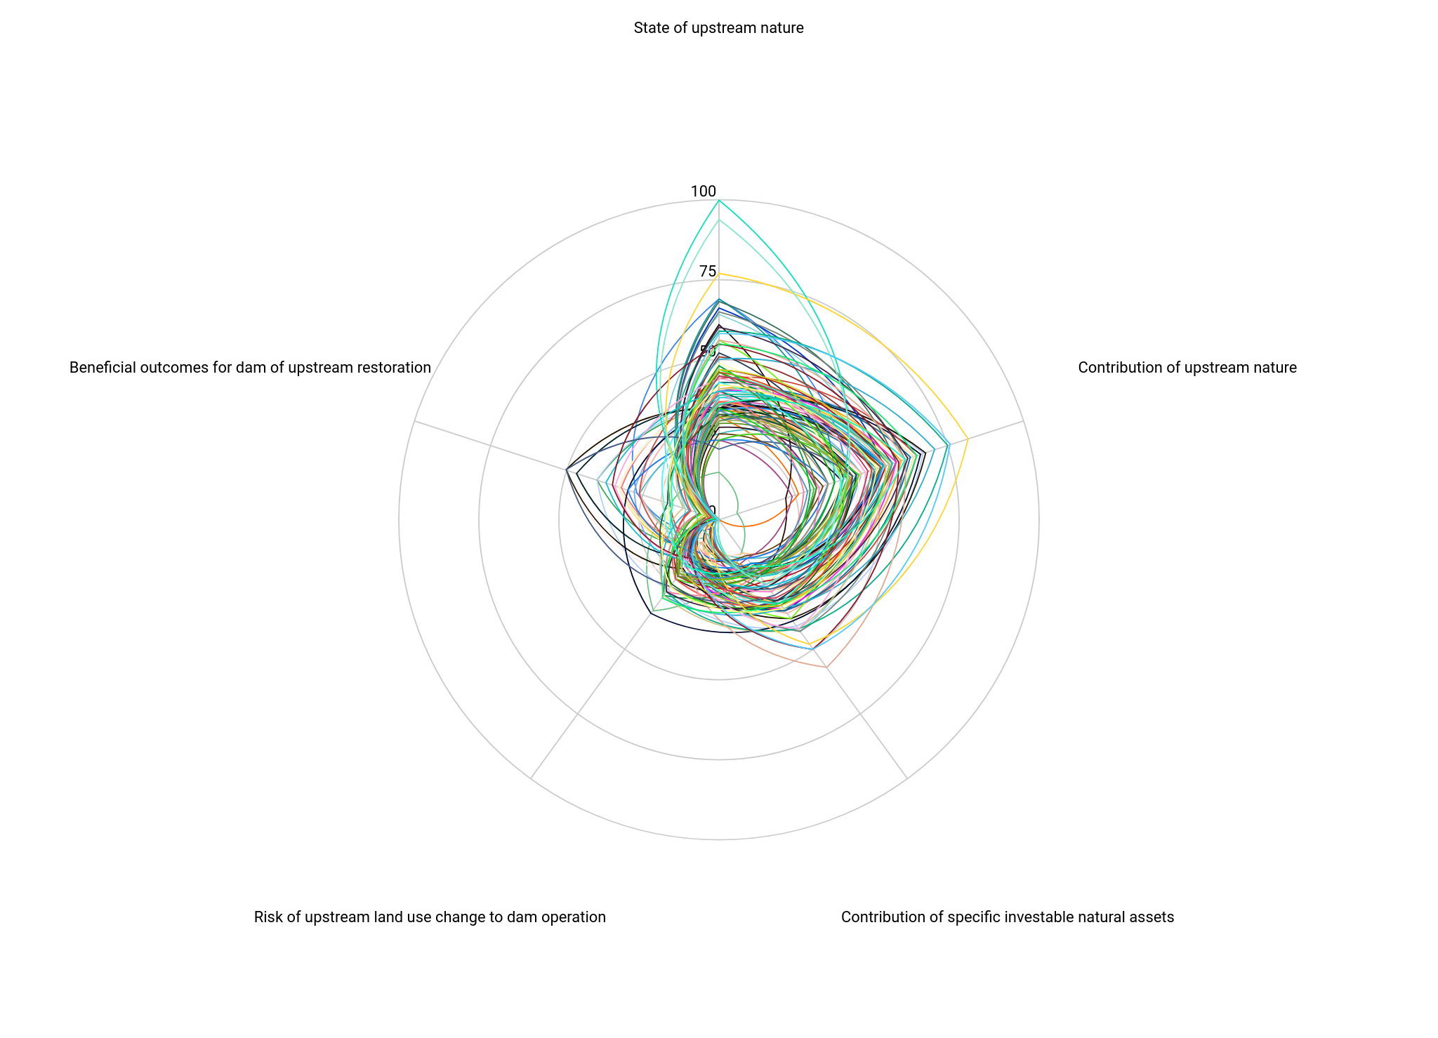
Results by dam (608 dams HEP>2MW)
STATE: Variable: good for some dams, poor for many, in need of improvement
BENEFITS: In many cases low (the restoration scenario is far upstream for many dams, thus has few benefits for flow, only for sedimentation)
CON: Full range, but many dams with contribution >50%
RISK: Full range, many dams with risk 25-50% of current contribution under scenario
ASSETS: Full range, but many dams with investable natural asset contribution 25-50%
Notes:
Here we show how the dams differ with respect to the need to protect the current state or contributions, the risk of loss for these and the potential benefits of restoration

Slide 11
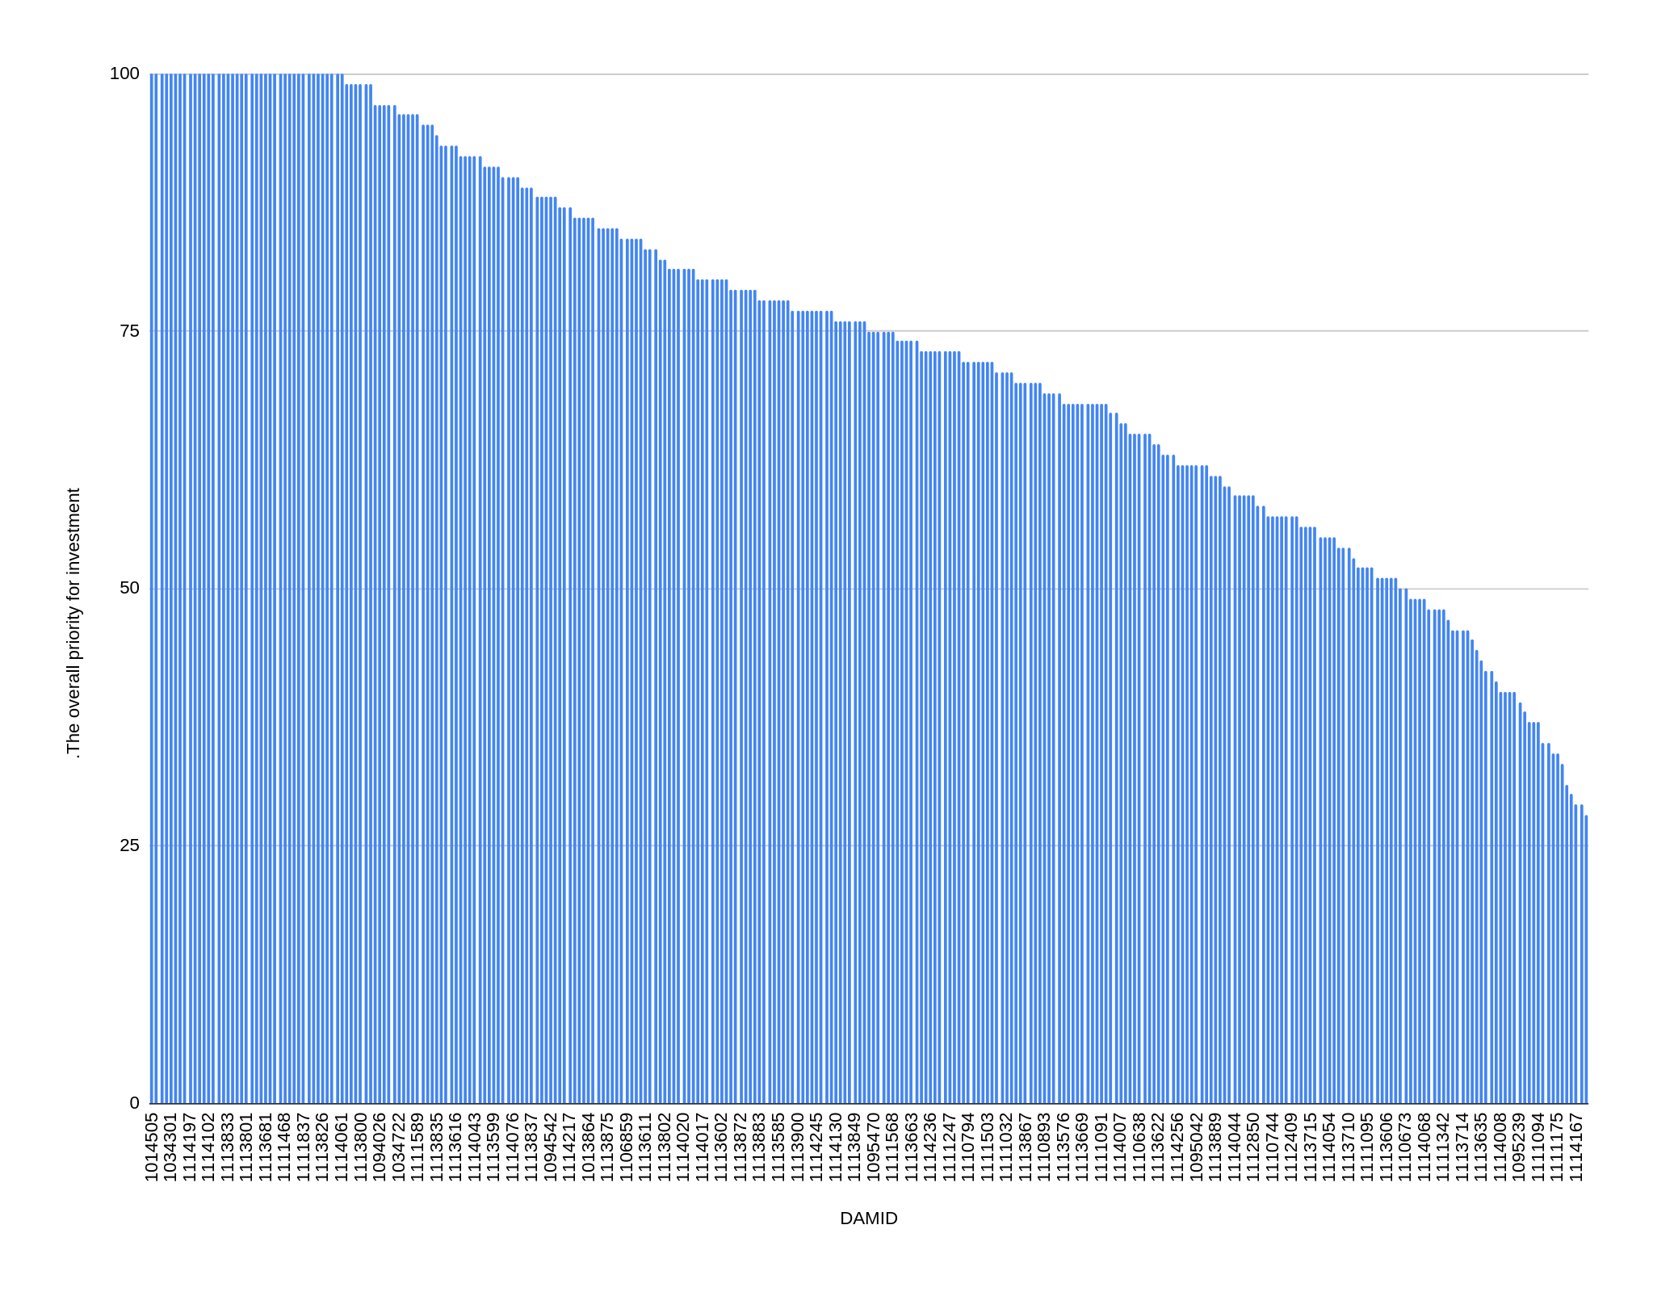
Overall investment priority for each dam
Some dams are high priorities for investment and others not
Low priorities for investment. Meaning:
Poor state of upstream nature
Low contribution of nature to dam
Few specific natural assets contributing
Low risk from deforestation scenario
Low benefits from restoration scenario
High priorities for investment. Meaning:
Good state of upstream nature
High contribution of nature to dam
Many specific natural assets contributing
High risk from deforestation scenario
High benefits from restoration scenario
GDW ID for dam

Slide 12
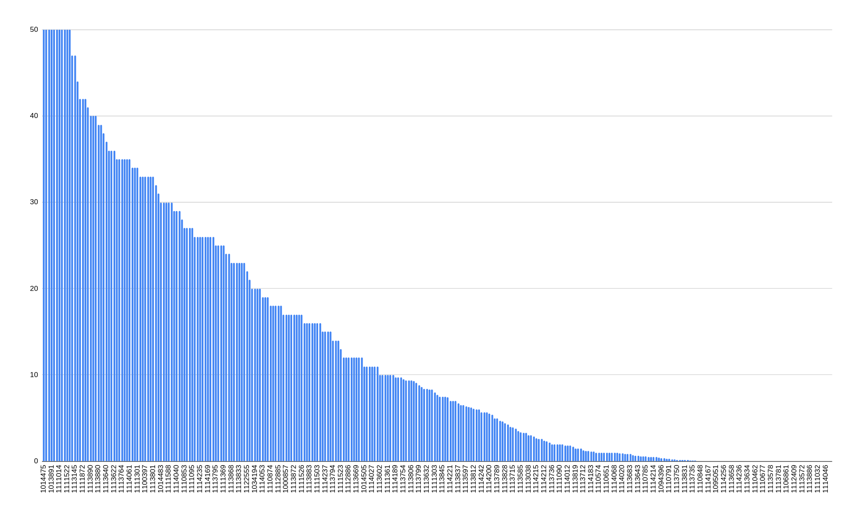
Benefits of restoration for each dam
Some are particularly high priorities for restoration
High benefits from restoration scenario
Benefits of restoration scenario
Low benefits from restoration scenario
GDW ID for dam

Slide 13
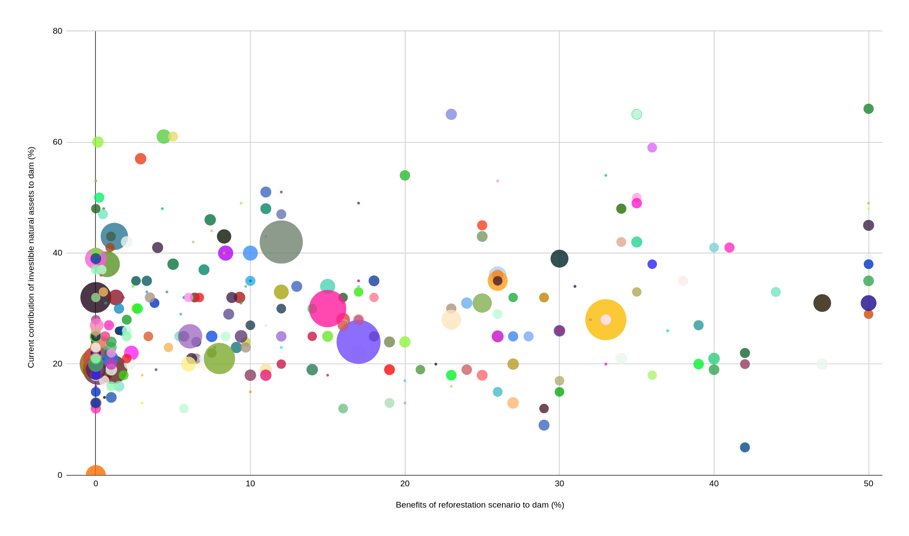
Priority dams for upstream investment
To improve the effectiveness of dam operations:
To improve the effectiveness of dam operations:
EACH ICON IS ONE DAM (>2MW), ICON SIZE = MW HEP CAPACITY
PROTECT EXISTING NATURE
CURRENT CONTRIBUTION OF INVESTABLE NATURAL ASSETS (%)
RESTORE NATURE
BENEFITS OF REFORESTATION (%)
Notes:
The diagram shows that some dams have a significant contribution now and are priorities for upstream investment for protection whilst other dams might contribute little now but would have significant benefits of restoration

Slide 14
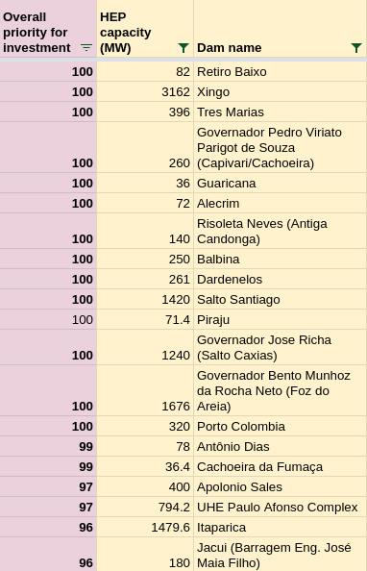
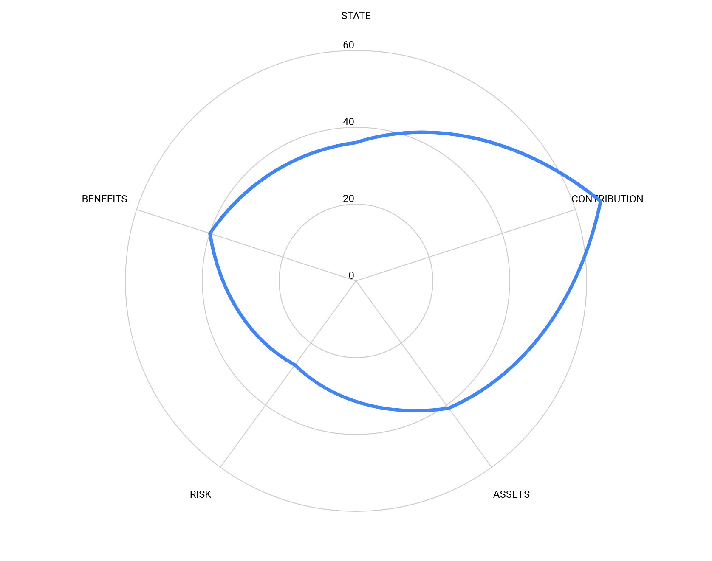
Top priority dams (>30 MW)
STATE
BENEFITS
CON
RISK
ASSET
Retiro Baixo:
Watershed could be in better state
Nature contributes much to the dam
Some investable assets contribute much
Risk is medium and benefits of restoration high

Slide 15
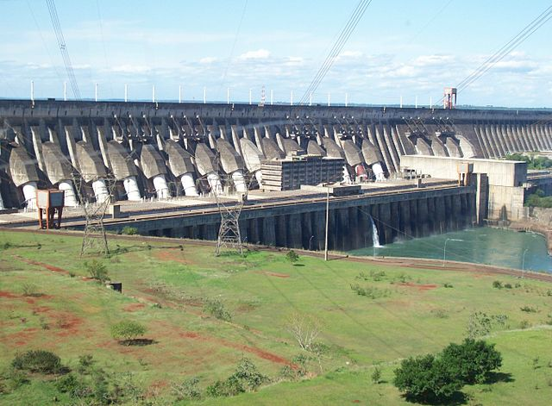
Conclusions
A tool has been developed which brings together WaterWorld and GlobalDamWatch to better target conservation and restoration investments for the benefit of downstream dams
The tool shows the % contribution or % change in contribution of nature to the operational conditions dams, for annual and seasonal water and sediment inputs
Sophisticated spatial models are required to understand these priorities
We highlight the diversity of dam situations in terms of current contributions of upstream nature and benefits that could accrue from restoration
A series of priorities are identified for further investigation as part of the BEM process
The tools presented are freely available

Slide 16
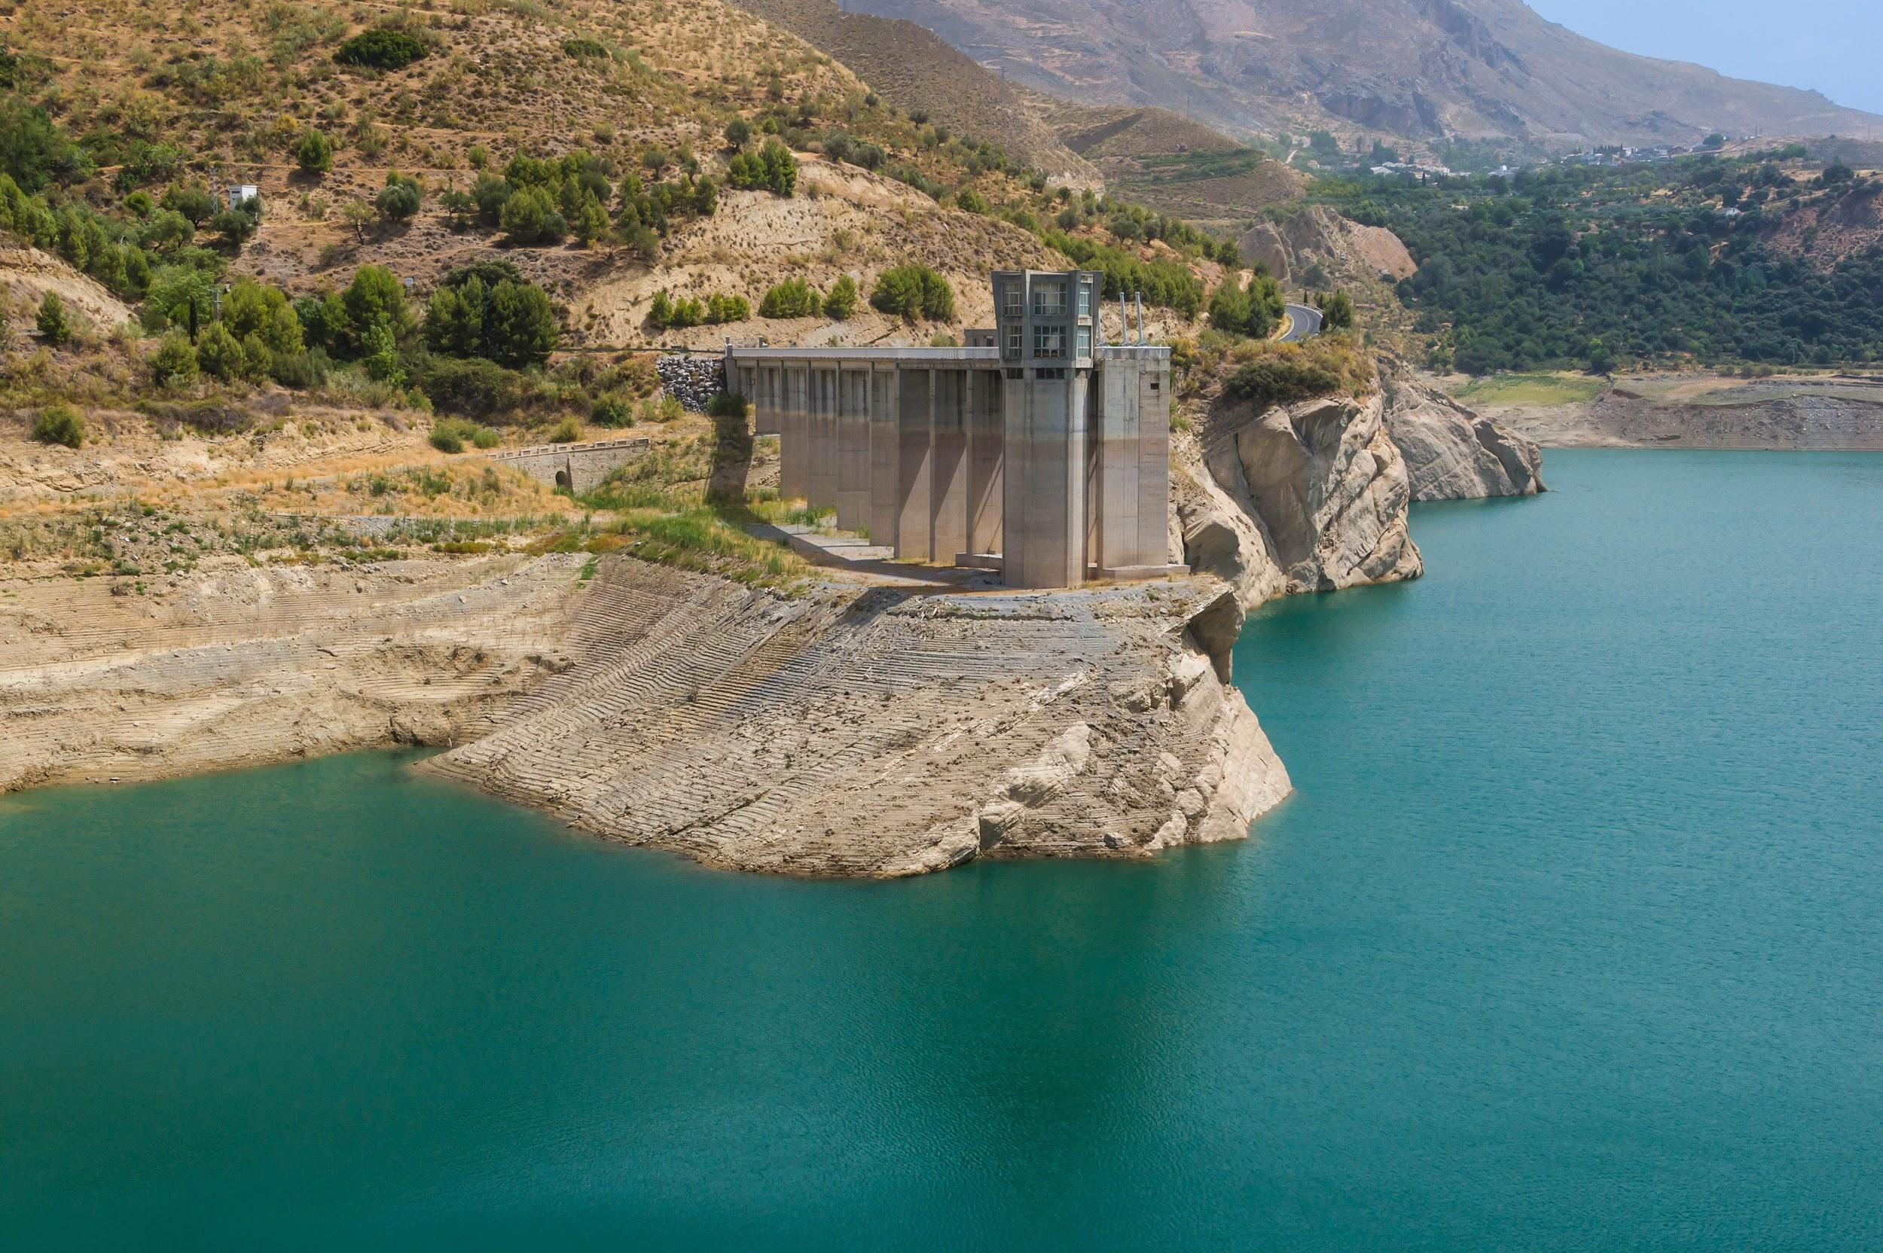
Thank you
mark.mulligan@kcl.ac.uk @markmulligan
www.policysupport.org/waterworld
www.globaldamwatch.org

Slide 18
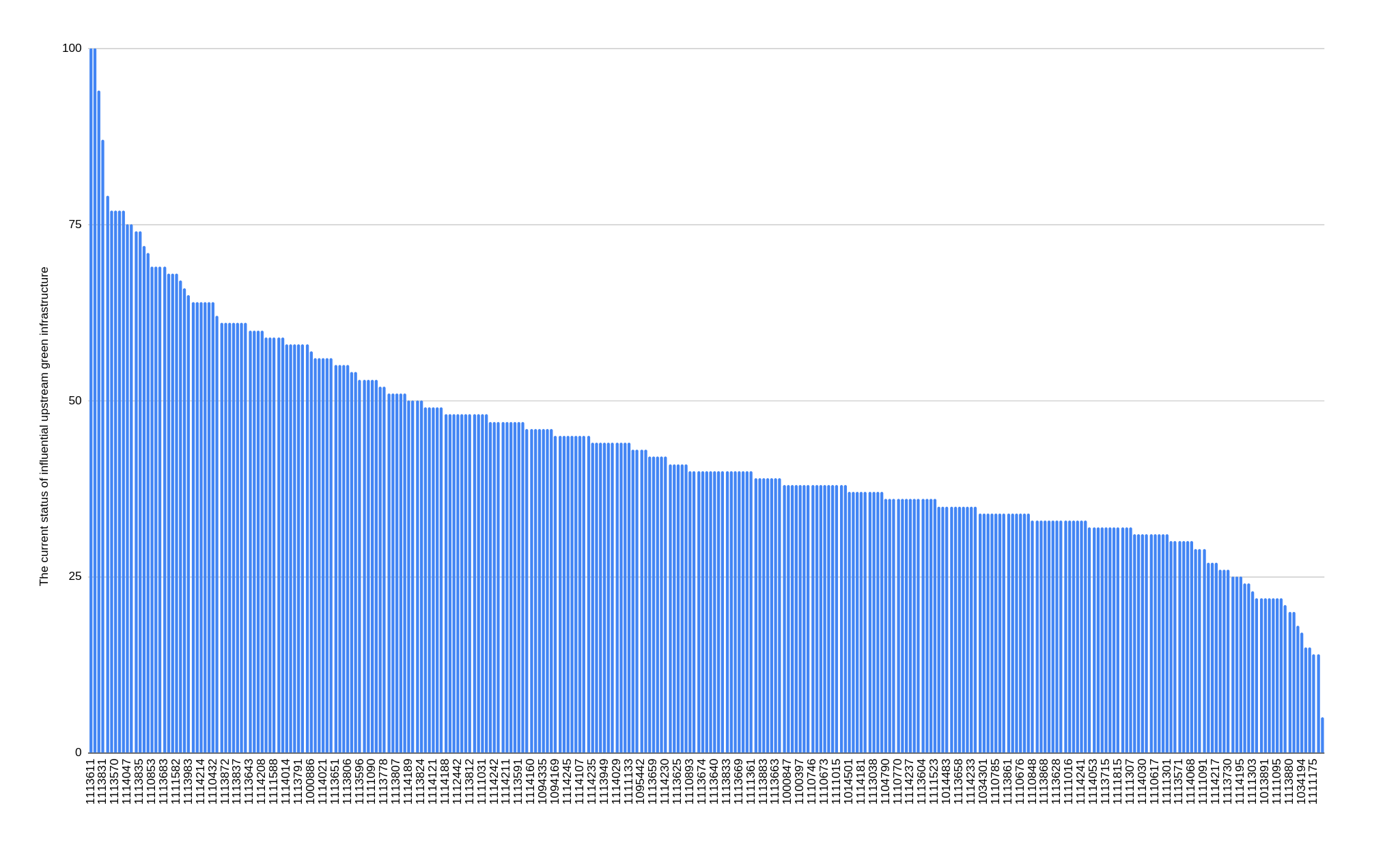
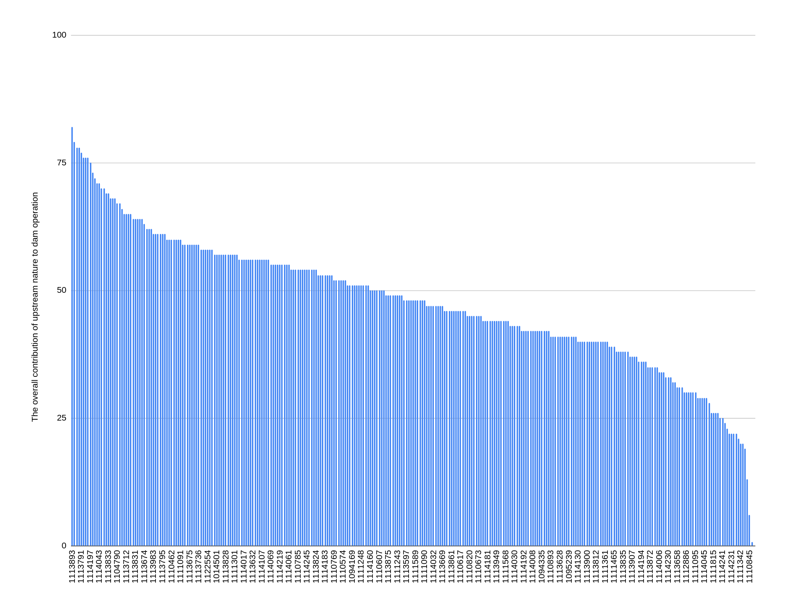
High state of upstream nature
Low state of upstream nature
State of upstream nature
High contribution of nature to dam
Low contribution of nature to dam
Contribution of nature to dam

Slide 19
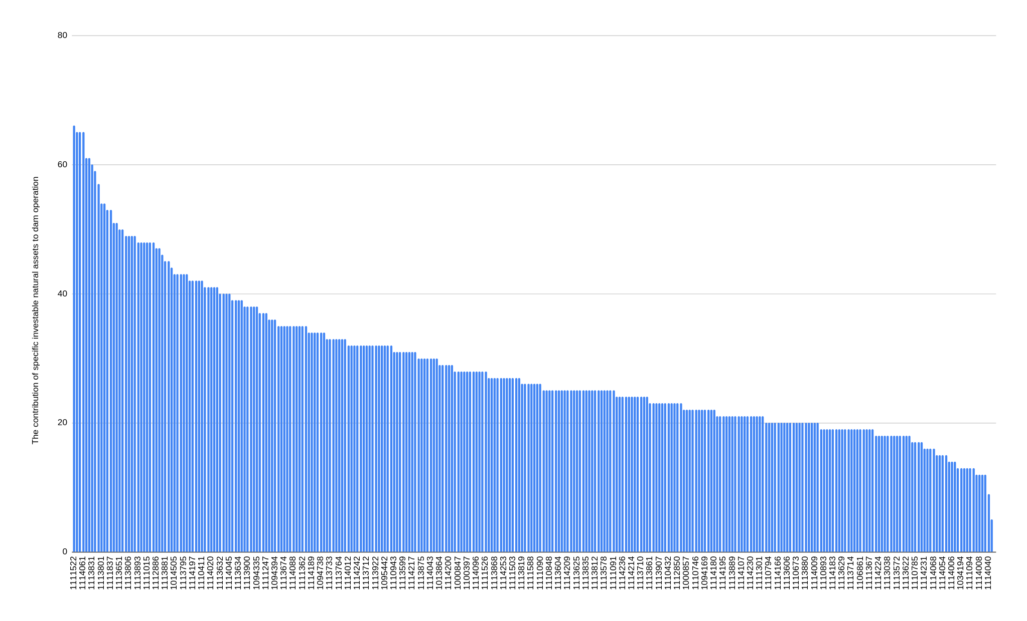
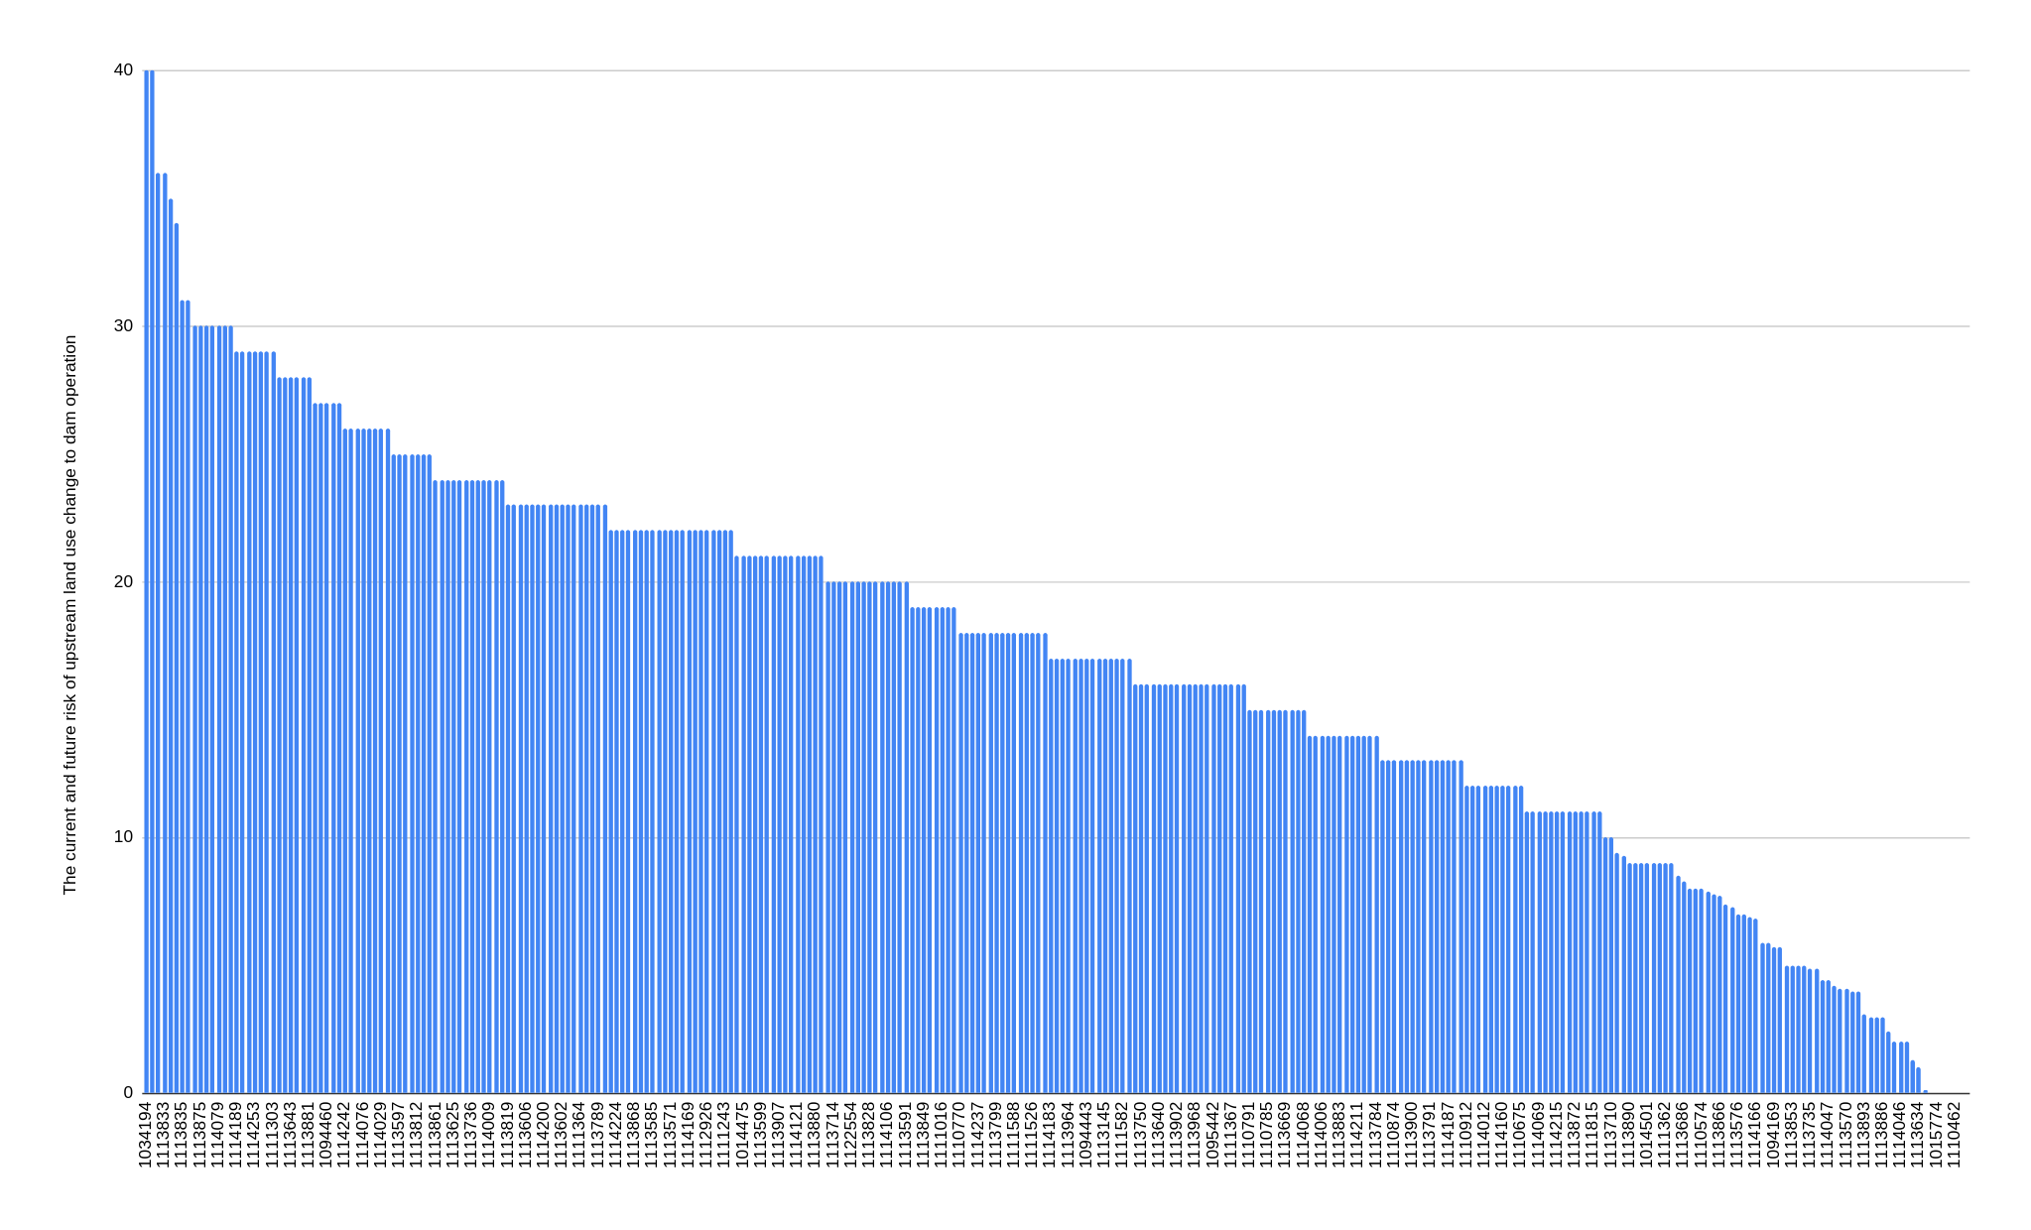
High contribution of investable assets
Low contribution of investable assets
Contribution of investable natural assets to dam
High risk to dam from deforestation scenario
Low risk to dam from deforestation scenario
Risk to dam from deforestation scenario

Slide 20
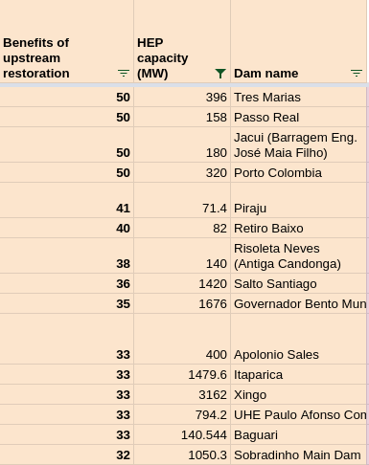
Top priority dams (>30 MW) on the basis of benefits of restoration

